Slide 1
Lecture 05
Principal Component Analysis (PCA)

Slide 2
Principal Components Analysis (PCA)
→ PCA is a useful statistical technique for finding patterns in data of high dimension.
→ It is used to express the data in such a way as to highlight their similarities and differences.

Slide 3



Background Statistics
→ Mean
→ Standard Deviation
→ Variance

Slide 4


Covariance
→ Standard deviation and variance can only operate one dimensional data.
→ Covariance is a measure of how much two dimensions vary from the mean with respect to each other.

Slide 5
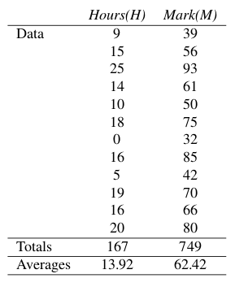
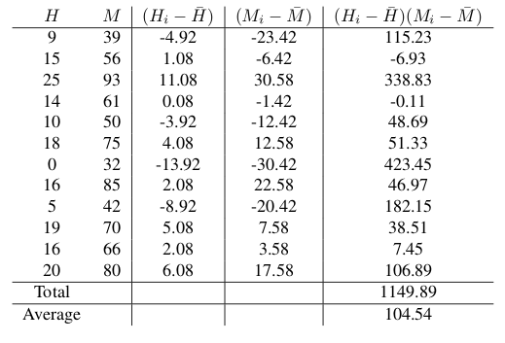
Covariance: An Example
→ Positive value indicates both dimensions increase together.
→ Negative value indicates as one increases, the other decreases.
→ Zero indicates dimensions are independent.

Slide 6

Covariance matrix

Slide 7
Eigenvector and Eigenvalue
→ An eigenvector or characteristic vector of a square matrix is a vector that does not change its direction under the associated linear transformation.
→ If v is a vector that is not zero, then it is an eigenvector of a square matrix A if Av is a scalar multiple of v. This condition could be written as the equation:
Av = λv where λ is the eigenvalue

Slide 8
An Example
→ Find the eigenvector and eigenvalue of the following matrix.

Slide 9
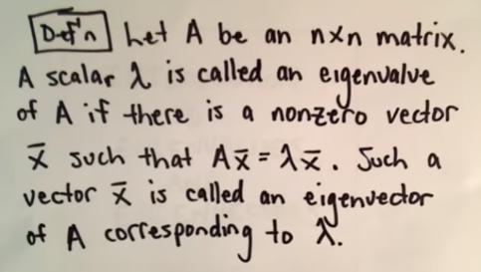
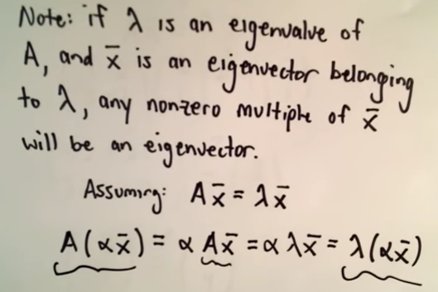
Eigenvector and Eigenvalue

Slide 10
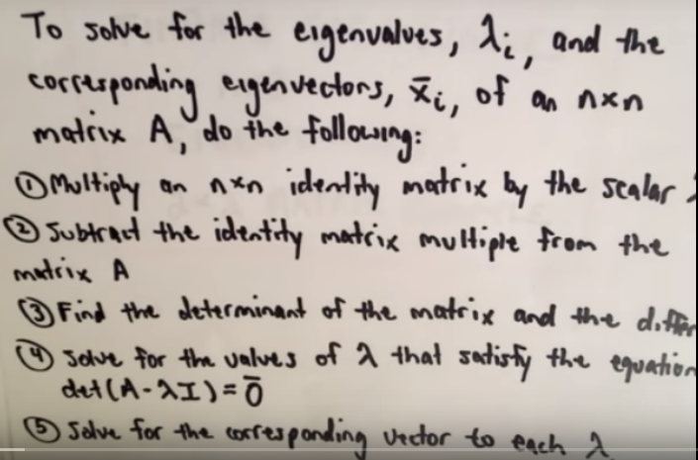
Finding eigenvector and eigenvalue

Slide 11


Finding eigenvector and eigenvalue

Slide 12





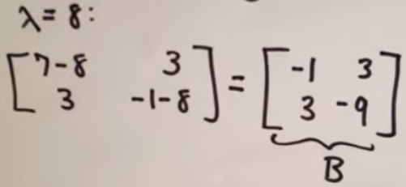
Finding eigenvector and eigenvalue

Slide 13




Finding eigenvector and eigenvalue

Slide 14
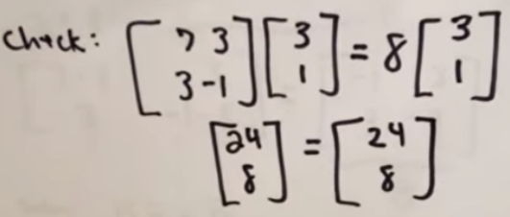

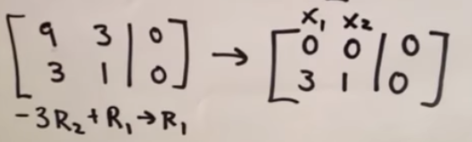
Finding eigenvector and eigenvalue

Slide 15
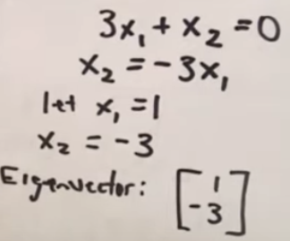

Finding eigenvector and eigenvalue

Slide 16
Steps of PCA
→ Step 1: Get some data
→ Step 2: Subtract the mean
→Step 3: Calculate the covariance matrix
→Step 4: Calculate eigenvectors and eigenvalues of covariance matrix
→Step 5: Choosing components and forming a feature vector

Slide 17
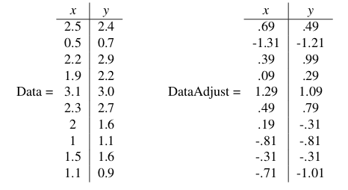
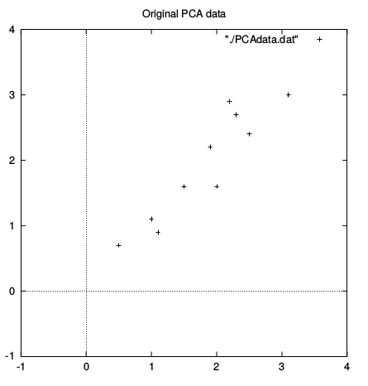
Dataset and subtracting the mean

Slide 18

Calculating the Covariance matrix

Slide 19
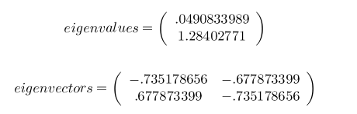
Eigenvalues and Eigenvectors

Slide 20
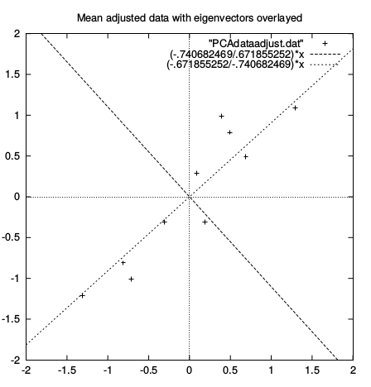
Eigenvalues and Eigenvectors

Slide 21


Forming a feature vector
→The eigenvector with the highest eigenvalue is the principle component of the data set.
→ Sort the eigenvalues in descending order.
→ From n eigenvalues, take top p eigenvalues.
→ Dimensions will be changed from n to p.

Slide 22

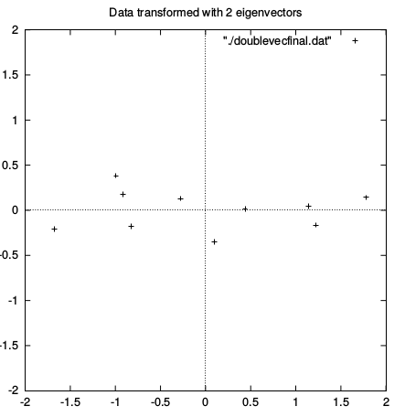
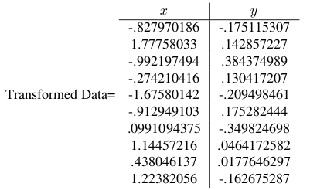
Deriving new dataset
→Take the transpose of the vector and multiply it on the left of the original data set, transposed.

Slide 23
Old and new dataset

Slide 24

Getting Original Data back
→Getting back exact original data is only possible if we take all eigenvectors during transformation. Otherwise, we lose some information.

Slide 25
References
[1] http://sebastianraschka.com/Articles/2014_pca_step_by_step.html
[2]

